Slide 1





Problem Statement ID – PRPCEMS15
Problem Statement Title - Student Innovation
PS Category - Software
Team ID – PRPCEMH164
Team Name - Cognitive Developers
Team Leader Name – Krushna S Mohod (9834714379)

Slide 2

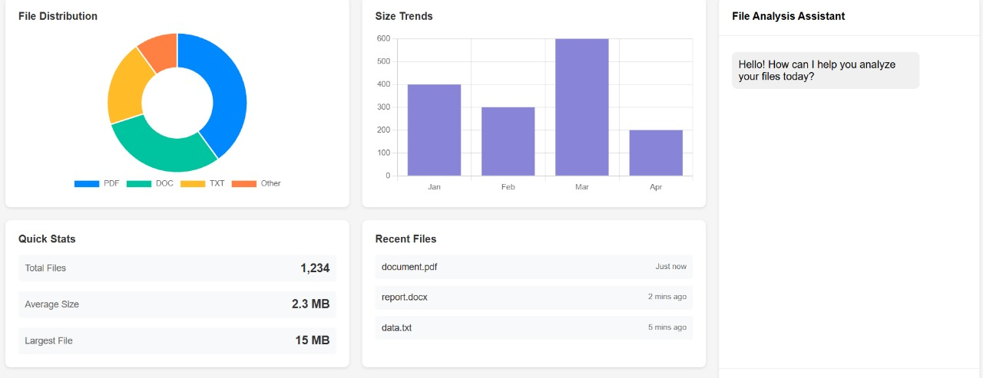
AI based Data Visualization Website
Cognitive Developers
Proposed Solution
Challenges faced by normal peoples:
Normal peoples can’t effectively process and analyze this data for decision-making.
Need :
AI Based Solution to get
visualization and Statistics from
the structured datasets
Problem :
Organizations generates datasets and can’t extract visualizations from it
Tasks:
Upload datasets.
Analyze data with pre-defined tools (e.g., histograms, line plots, statistical summaries).
Get AI-driven insights and feedback.
AI-assisted suggestions for data analysis
PRPCEM HACKATHON' 25

Slide 3

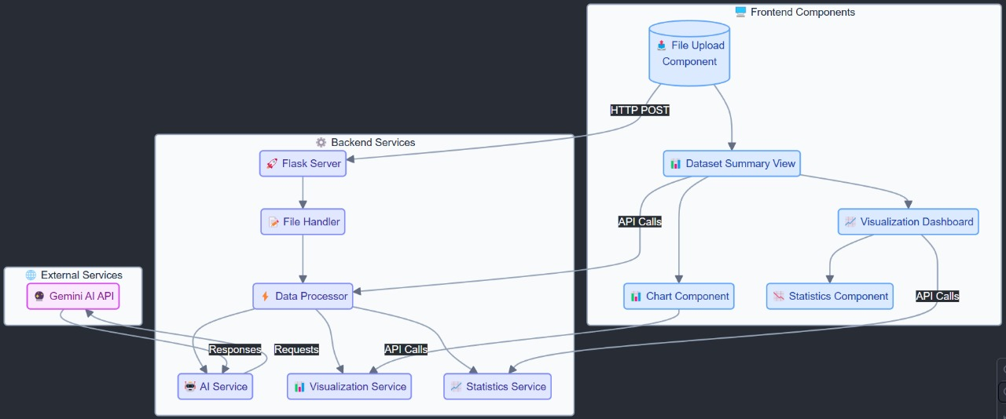
TECHNICAL APPROACH
Cognitive Developers
Tech stack:-
Programming Languages: Python, Html CSS, JavaScript
Frameworks: Flask (backend), HTML/CSS/JS (frontend).
Libraries: Pandas, Matplotlib, Plotly, Scipy.
Flowchart
PRPCEM HACKATHON' 25

Slide 4




FEASIBILITY AND VIABILITY
Cognitive Developers
Feasibility:
A user-friendly platform that provides precise and interactive visualizations, enabling users to easily explore and understand their datasets.
Potential Challenges and Risks:
Large Datasets: Require high computational power for loading and generating visualizations efficiently.
Security Risks: Potential vulnerabilities with file uploads and sensitive data.
Strategies:
Large Datasets: Utilize GPU acceleration to improve processing speed
Security Measures: Implement strict file validation and secure handling of data and API keys.
PRPCEM HACKATHON' 25

Slide 5



IMPACT AND BENEFITS
Cognitive Developers
Impact
Encourages Data-Driven Decision Making:
Promotes the use of analytics in personal and professional settings for better decision-making.
Bridges the Skill Gap:
Provides a platform for non-technical users to understand and utilize data effectively.
Democratizes Data Analysis:
Makes data analytics accessible to individuals and organizations with limited resources.
Boosts Innovation:
Enables users to identify patterns and trends, leading to innovative solutions in various fields.
Benefits
Social:
Provides affordable tools, empowering underprivileged communities to leverage data analytics.
Economic:
Saves costs for startups by offering an alternative to expensive tools.
Educational:
Enhances learning with a hands-on platform for students and educators to explore data concepts.
Technical:
Showcases open-source power with AI-driven insights and predictive analytics.
PRPCEM HACKATHON' 25

Slide 6


RESEARCH AND REFERENCES
Cognitive Developers
Details / Links of the reference and research work:
Github Repository
Smits, A. J. (2012). Flow visualization: techniques and examples. World Scientific.
Danaher, J. (2018). Toward an ethics of AI assistants: An initial framework. Philosophy & Technology, 31(4), 629-653.
Markman, A. B. (2013). Knowledge representation. Psychology Press.
Waskom, Michael L. "Seaborn: statistical data visualization." Journal of Open Source Software 6, no.
60 (2021): 3021.
Habib, M., & Okayli, M. (2024). Evaluating the sensitivity of machine learning models to data preprocessing technique in concrete compressive strength estimation. Arabian Journal for Science and Engineering, 1-19.
Singh, S. and Singh, N. (2011) Big Data Analytics. 2012 International Conference on Communication,
Information & Computing Technology Mumbai India, IEEE, October 2011.
Müllner, L. (2021). Knowledge-assisted visual analytics: data exploration and insight generation of health care data (Doctoral dissertation, Wien).
PRPCEM HACKATHON' 25

